Slide 1
Supporting the Mental Health of Faculty and Staff
Notes:
Tom
We’re going to give a short overview of services and trends, will have time for discussion and to hear from you about your concerns

Slide 2
Introductions
Tom Waldecker, Director of Faculty and Staff Counseling and Consultation Office
Jill Castro, Senior Faculty and Staff Counselor, Faculty and Staff Counseling and Consultation Office
Kelcey Stratton, Chief Behavioral Health Strategist, Clinical Assistant Professor in Psychiatry
Notes:
Tom
Explain all of our roles: Intro and what we do

Slide 3
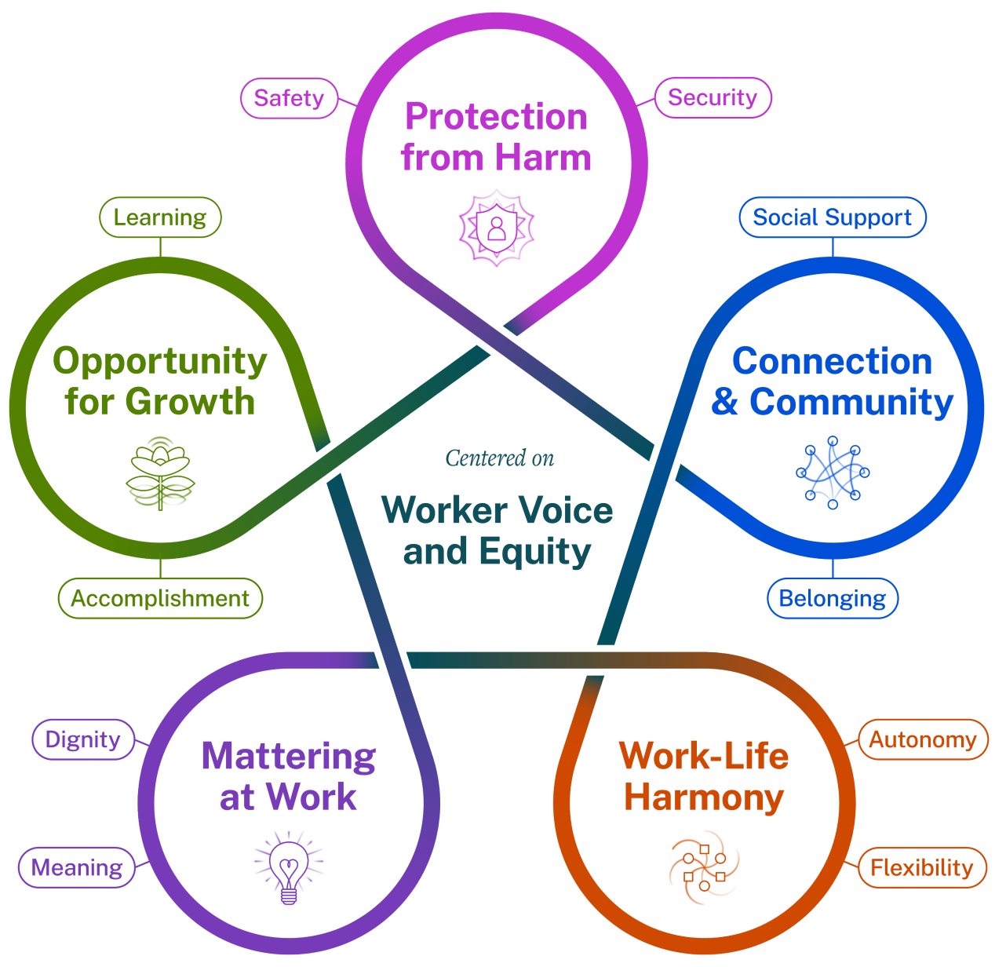
Five Essentials for
Workplace
Mental Health and Well-Being
Source: The U.S. Surgeon General’s Framework for Workplace Mental Health & Well-Being
Notes:
Kelcey
Part 1: Framing the conversation by introducing models of well-being - 3 levels of intervention: individual, team, organizational
I wanted to share the Surgeon General’s framework for workplace mental health and well-being as I believe the model is aligned with U-M philosophies of mental health and well-being, e.g., U-M’s Philosophy of Well-Being, Wellness Office model of multiple domains of well-being.
The Surgeon General’s model illustrates essential elements - noted in the circles - that help people grow and thrive in the workplace.
This model is informed by decades of research in public health, psychology, and sociology.
Each Essential is grounded in two human needs, shared across industries and roles. Human psychological needs are represented in each essential element. People spend a significant portion of their lives at work, and we must consider how workplaces contribute to overall health and well-being.
76% of U.S. workers reported at least one symptom of a mental health condition.
84% of respondents said their workplace conditions had contributed to at least one mental health challenge.
81% of workers reported that they will be looking for workplaces that support mental health in the future.

Slide 4
Prevalence of Depression and Anxiety
Among U-M Faculty and Staff
Depression and anxiety have increased from 2018-2021
e.g., depression among campus staff: 9.2% → 12.0%
e.g., anxiety among campus faculty: 5.8% → 8.6%
Depression prevalence is similar among staff and faculty at U-M campuses, but higher among staff at Michigan Medicine
In 2021: 13.0% (staff) vs. 7.4% (faculty) at MM
Anxiety prevalence is higher among staff than among faculty
In 2021: 10.2% (staff) vs. 8.6% (faculty) at all U-M campuses; 11.4% vs. 5.1% at MM
Source: University of Michigan Benefits Office, 2018-2021 Benefits Claims Data
Notes:
Kelcey
Here are some U-M trends, based on health benefits claims.
Note that these are a few highlights from larger set of benefits claim data.
We want to highlight the overall trends: claims for both depression and anxiety are increasing, and there are some differences between faculty and staff in terms of prevalence of depression and anxiety.
Depression and anxiety have increased.
These are just two examples from the data that we are sharing to give you an idea of the rate on increase over the past 4 years.
Depression. On all U-M campus excluding MM, depression is relatively similar among both staff and faculty. However, at MM, prevalence of depression claims is higher among staff in all of the past 4 years.
Anxiety. All campuses and at MM, prevalence of anxiety claims is higher among staff than faculty in all of the past 4 years.

Slide 5
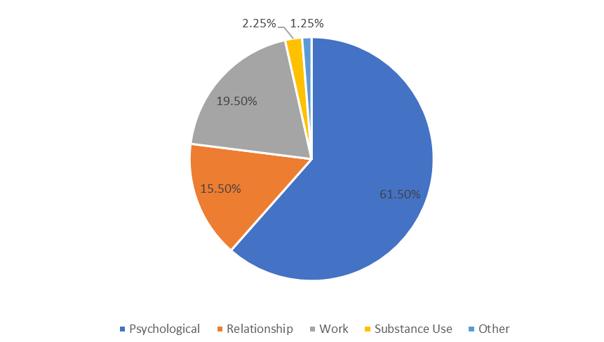
Primary Presenting Concerns
for OCWR and FASCCO Counseling
Source: Faculty and Staff Counseling and Consultation Office, Office of Counseling and Workplace Resilience
Notes:
Kelcey
For those faculty and staff seeking services through one of our Employee Assistance Programs, we have data on their primary concerns and reasons for seeking counseling support.
This chart shows the combined percentages from OCWR and FASCCO for a quick summary, based on 2022 data.
Interesting to note that these percentages have shifted since COVID.
In past, Psychological/Emotional, Relationship, and Job/Work concerns were evenly distributed in thirds.
In last 3 years, Psychological/Emotional concerns are given far more often as the main reason people are seeking counseling from OCWR and FASCCO.

Slide 6
FASCCO Trends
Increase in psychological concerns (now 60+%)
Decrease in stigma (60% of first time clients have less than 5 years of employment)
Increase in individuals needing referrals for higher level care/specialists (many have waitlists)
Highest percentage ever of self-referred clients
Increase in family members utilizing services
Increase in online presence and increase in access with virtual services
Demographics have stayed the same
Notes:
Jill

Slide 7
Mental and Emotional Health Strategies and Resources
Education
Ensure broad base of knowledge about mental and emotional health topics and resources, de-stigmatize mental health concerns.
Prevention and Early Identification
Promote resilience, early identification of distress, offer trauma-informed care, proactive interventions to maintain well-being.
Mental Health Support Services
Provide access to a range of compassionate mental health support services that meet needs of individuals and teams.
References: Substance Abuse and Mental Health Services Administration (2014). SAMHSA’s concept of trauma and guidance for a trauma-informed approach;
Watson, P. J., & Westphal, R. J. (2020). Stress First Aid for Health Care Workers. U.S. Department of Veterans Affair. National Center for PTSD; Seligman, M. E. (2012). Flourish: A visionary new understanding of happiness and well-being. Simon and Schuster.
Notes:
Jill

Slide 8
FASCCO Offerings
Free short-term counseling for faculty and staff
Individuals, couples, and eligible adult dependents (18+)
Consultation with supervisors and administrators
Referral services
Identification of community and University resources
Crisis/grief support
Support groups
Sample of offerings: New Moms Returning to Work, LGBTQ+ Faculty & Staff, Divorce/Separation, Preparing for Retirement, Managing Anger
Notes:
Jill

Slide 9
Sample of Presentations Offered
Quick Tips for Self-Care
Creating Healthy Boundaries
Introduction to Stress Management
Mindful Self-Compassion
Gratitude Workshop
Trauma 101
Enhancing Social Connections
Overview of Anxiety and Other Mental Health Conditions
OPR Training
Worry: Tips and Tricks for Pushing Back

Slide 10
Discussion
What are your concerns and interests about mental and emotional health in your department?
What would help positively support mental and emotional health, particularly at the work/team level?
Notes:
Tom
Other potential questions:
How can U-M positively support mental health, particularly at the work/team level and organizational level?
What can we do more of?
Where are the gaps or barriers?
What are some best practices from your area that support workplace mental health?

