Slide 1
Associate Deans Group
April 14, 2023
Slide design by Michaela Zint

Slide 2
Group 1. Support Faculty Professional Development (PD)
Adopt/implement Emory University’s Piedmont model (i.e., interdisciplinary PD for infusing climate/sustainability education) to support individual faculty
Create PD (modeled after U-M MORE committee) to support infusion of climate/sustainability education within departments
As part of both of the above, include content on climate justice/anxiety/resilience/linkages to DEI/decolonizing, student success and effective pedagogies
Hold annual climate education event (feature best practices from campus and beyond)
incorporate into above PD
Conduct baseline survey to assess current infusion of climate education in curricula, to identify best practices & measure progress over time
Create incentives/support infusion of climate education into curricula in addition to PD structure for PD (fund students to support infusion, offer unit/university wide awards, recognize effort/progress/innovation not just accomplishment, stipends for faculty, adjust P&T/annual evaluations)
Need to not overwhelm faculty!
✣

Slide 3
Group 1) Already In Process: CRLT will pilot an Embed Climate
Change in Courses (EC^3) Retreat
When: July 11 & 12, 2023
Where: Adventure Education Center at Radrick
Goal: Provide a community of support to faculty interested in embedding education on climate change into an existing course.
Structure: Loosely modeled after Piedmont Project at Emory. Mix of presentations, discussion, individual planning, & peer feedback. Reunion in AY 2023-2024 to compare notes and share experiences.
Stipend: $500 stipend for 15-20 participants
Application: Distributed in Late April/Early May
✣
Notes:
Matt to add information based on his email to me/Michaela (see below)
Hi Michaela. I wanted to give you a heads-up about an event CRLT is working to organize that is a direct outcome of the Provost’s Seminar you and your students worked so hard on. Please note that this program will not involve work on your part. Deb Meizlish is collaborating with Sara Soderstrom on planning and organization.
Here’s some background: At the Provost’s Seminar lunch on Tuesday, Deb was involved in a conversation with several faculty, including Sara Soderstrom, who expressed interest in piloting a course planning retreat modeled after Emory’s Piedmont Project. The goal would be to provide a community of support to faculty interested in embedding education on climate change into an existing course. Deb approached Malinda and me about the possibility of using CRLT’s faculty learning community funding to support the idea (this is a pool of money CRLT consultants can apply to use for one-time pilots of faculty learning communities that they design and facilitate or co-facilitate). We have approved using this money for a pilot which would provide up to 20 participants with a $500 stipend.
Deb has had preliminary conversations with Sara Soderstrom, and they are hoping to pull together a 2-day retreat for May 17th & 18th. If that proves impossible, they will work towards a retreat in the 2023-2024 academic year.
Deb and Sara would be glad to provide more information as the details (e.g., finding a space) get finalized. In the meantime, if you are available to attend a possible May retreat, we wanted to make sure you could hold the dates for now.
Best,
Matt

Slide 4
GROUP 1
Group members names:
<write names here>
a. How supportive might your unit be to advance these recommendation? Why/not? How could your unit support these recommendations?
b. How might these recommendations help your unit move forward with infusing climate education across your curricula?
c. What questions/concerns do you have about these recommendations?
Faculty need more concrete information about linkages between climate change/sustainability and their profession (e.g. pharmacy, different health professions) -> next climate education even could focus on different units and customization for their needs. (need to help units see connections to climate change)
Need incentives from the university - e.g. theme semester … Need support from university - e.g. composting …Need advice/guide from university re traveling
Impact (are we having positive impact through curriculum - what value is PD showing - impact on students/curriculum/unit)
Please add initials next to responses

Slide 5
Group 2 Transform U-M into a Campus Living Lab
Create an asset map of living learning lab opportunities across U-M campuses
See the Wellbeing Collective website as a potential template
Centralized office/position for “campus-as-lab” coordination, with funding, resources, and logistical support for faculty to integrate living learning lab experiences into existing courses
Expand funding and support for university-wide communities of practice in climate/sustainability
Coordinate with facilities to employ students in campus operations and/or host interdisciplinary student project teams to push forward carbon neutrality goals
Example: Stanford’s Living Lab Fellowship Program
Leverage existing community engagement structures across campus to use Michigan communities as living labs for sustainability and climate mitigation/adaptation strategies
Ginsburg, SEAS Sustainability Clinic, Public Health Action Support Team, etc.
Develop hands-on learning experiences for regionally specific decarbonization projects
✣

Slide 6
GROUP 2
Group members names:
<write names here>
a. How supportive might your unit be to advance these recommendation? Why/not? How could your unit support these recommendations?
Not clear what the opportunity is for SSW – and it is not embedded in the teaching
SSW does not see as they can contribute to it – there should be specific language about the social issues
Ford has a core of faculty who is very interested, and are striving to establish cross-school collaboration
The university needs a structure to coordinate the sustainability work: there are really two options: one is a central role (e.g. vice provost, but very expensive), another is a committee model – collaboration among the units who are involved in sustainability – representatives come together into a committee with a rotating chair— two different models [john ciorciari]
b. How might these recommendations help your unit move forward with infusing climate education across your curricula?
c. What questions/concerns do you have about these recommendations?
Please add initials next to responses

Slide 7
Group 3: Integrate Climate Education and Sustainability across the Curriculum
Expand upon sustainability citizen at U-M (Toronto model) to different forms of learning. Examples for the three levels:
Citizen: Planet Blue training for all incoming students (part of orientation)
Scholar: Sustainability Cord program expansion
Leader: Community-based projects
Develop a general degree requirement for climate change and sustainability modeled on the Race and Ethnicity LSA Requirement. Courses/co-curricular opportunities should be categorized or scaled to indicate the expected prerequisite knowledge. There should be ample opportunities for students to engage in climate/sustainability education across course levels.
Create and regularly update an inventory of classes and co-curricular opportunities (coded to the Sustainable Development Goals) for students to choose from. Included classes should be hands-on, experiential, real-world, and collaborative.
Create an accountability system within units to ensure quality designations, to ensure that courses meeting the graduation requirement address needed competencies and follow climate education best practices.
Provide support for faculty infusing climate education including syllabi, sample lesson plans, expert assistance, collectively curated pedagogies for climate education.
This support must ensure that climate education does no harm (raises climate anxiety) but empowers all but especially BIPOC/vulnerable students
✣

Slide 8
GROUP 3
Group members names:
<write names here>
a. How supportive might your unit be to advance these recommendation? Why/not? How could your unit support these recommendations?
Adding to IPE
Interested, but having a hard time imagining how to integrate. Operations, to help reduce waste in professional settings
b. How might these recommendations help your unit move forward with infusing climate education across your curricula?
External course, logistic nightmare for professional course
IPE 1 course, 1 semester
Consider People, Process, and Technology
c. What questions/concerns do you have about these recommendations?
How to integrate into a professional program where the curriculum is already so full
(Not what you teach but how you teach it)
Please add initials next to responses
Notes:
Faculty groups are working in this space, but it isn’t systematically infused
Some programs within Kin. more likely able to introduce some of these ideas.
Interest is there and support but how to strategically plan yet
Professional students credit hour

Slide 9
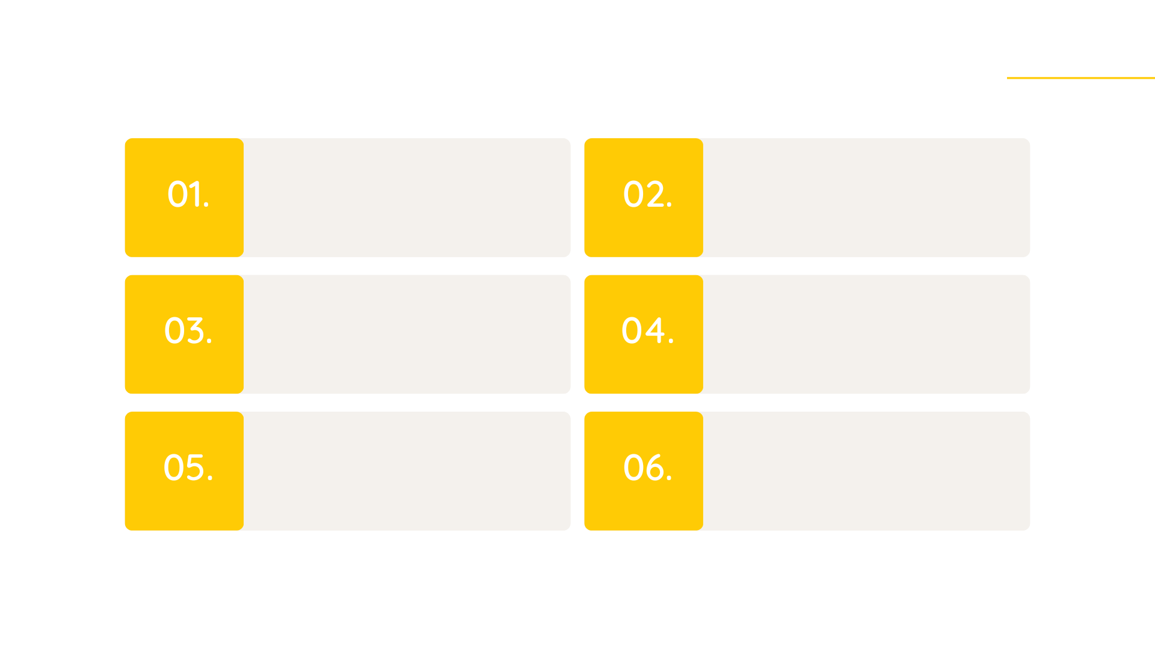
Group 4: Deploy Climate Education for Student Success
Create short video on what measures drive student success and how climate education can support this U-M goal
Partner with U-M DEI to advance climate education across U-M
Ensure faculty professional development addresses how climate education can improve student success
Identify U-M climate education efforts with the potential to support student success & share outcomes/best practices
Provide funding (through CRLT) for climate education that uses pedagogies that can lead to student success
Encourage Dean Michael Solomon to include climate education within context of “Provost’s Initiative Planning for Student Academic Success” and offer Q&A to both him and Provost McCauley
✣

Slide 10
Group 4: Deploy Climate Education for Student Success
Traditional Student Success Outcome | Outcome Advanced by Climate Education
Retention, Persistence, & Graduation Rates | Build community and passion around addressing climate change which can lead to sense of belonging
Moral development | Foster empathy for those experiences climate injustice
Cognitive and intellectual development | Enable students think critically about how to solve wicked problems associated with the climate crisis
Career and Economic Impacts of College | Prepare students in all disciplines for climate leadership within their careers
Quality of Life | Cultivate hands-on climate education that results in skills related to: adaptation/resilience, collaboration, community engagement, personal development, etc.
Can be achieved through professional development, integrating climate education across curriculum, & living learning labs
✣

Slide 11
GROUP 4
Group members names:
Robert Ortega - SSW
Seetha Monrad - Med School
a. How supportive might your unit be to advance these recommendation? Why/not? How could your unit support these recommendations?
CL: UMSI is going to involved creative problem solving pedagogies to address this issue. We are supportive of bring climate problems into that framing. In FS23 we have two degree programs focusing entirely on water quality for their introductory classes - approx. 575 students.
RO: SSW offers courses focusing on environmental justice. Ideally we would engage in more cross-listed courses but also consider how environmental justice adds to student internships locally, nationally and globally; perhaps consider it as part of our mission and add it as a program goal
SM: Supportive.
b. How might these recommendations help your unit move forward with infusing climate education across your curricula?
CL: IME, it’s a bad idea to make our educational outcomes dependent on other units. Recommendation 4 looks fine.
SM: It can help us prioritize multiple possible focuses around the social/environmental determinants of health that the medical school strives to support
As part of our SSW’s reaccreditation, an important aspect asks how our mission and goals are consistent with the University’s. We need to consider how the University prioritizes environmental education in it’s mission and goals and our professional school can align with that of the University
c. What questions/concerns do you have about these recommendations?
Are you trying to centralize climate education at the university or just setting parameters for climate education for different colleges?
Clarity around linking explicitly to supporting student success
Please add initials next to responses
Notes:
Reaccreditation - when climate education is at institutional level 0 can address as part accreditation

