Slide 1
Advancing Climate Education at U-M
Presentation to Associate Deans
April 14, 2023

Slide 2
Overview
Background Climate Education Seminar & Provost Seminar on Teaching & Learning (President Ono Introduction)
Event Feedback & Publicity
Results from Monday’s Student Breakout Sessions
Results from Tuesday’s Concurrent Sessions
Break Out Groups
Next Steps
Support Faculty Professional Development
Transform U-M into a Campus Living Lab
Integrate Climate Education and Sustainability across the Curriculum
Deploy Climate Education for Student Success
Other Key Recommendations

Slide 3
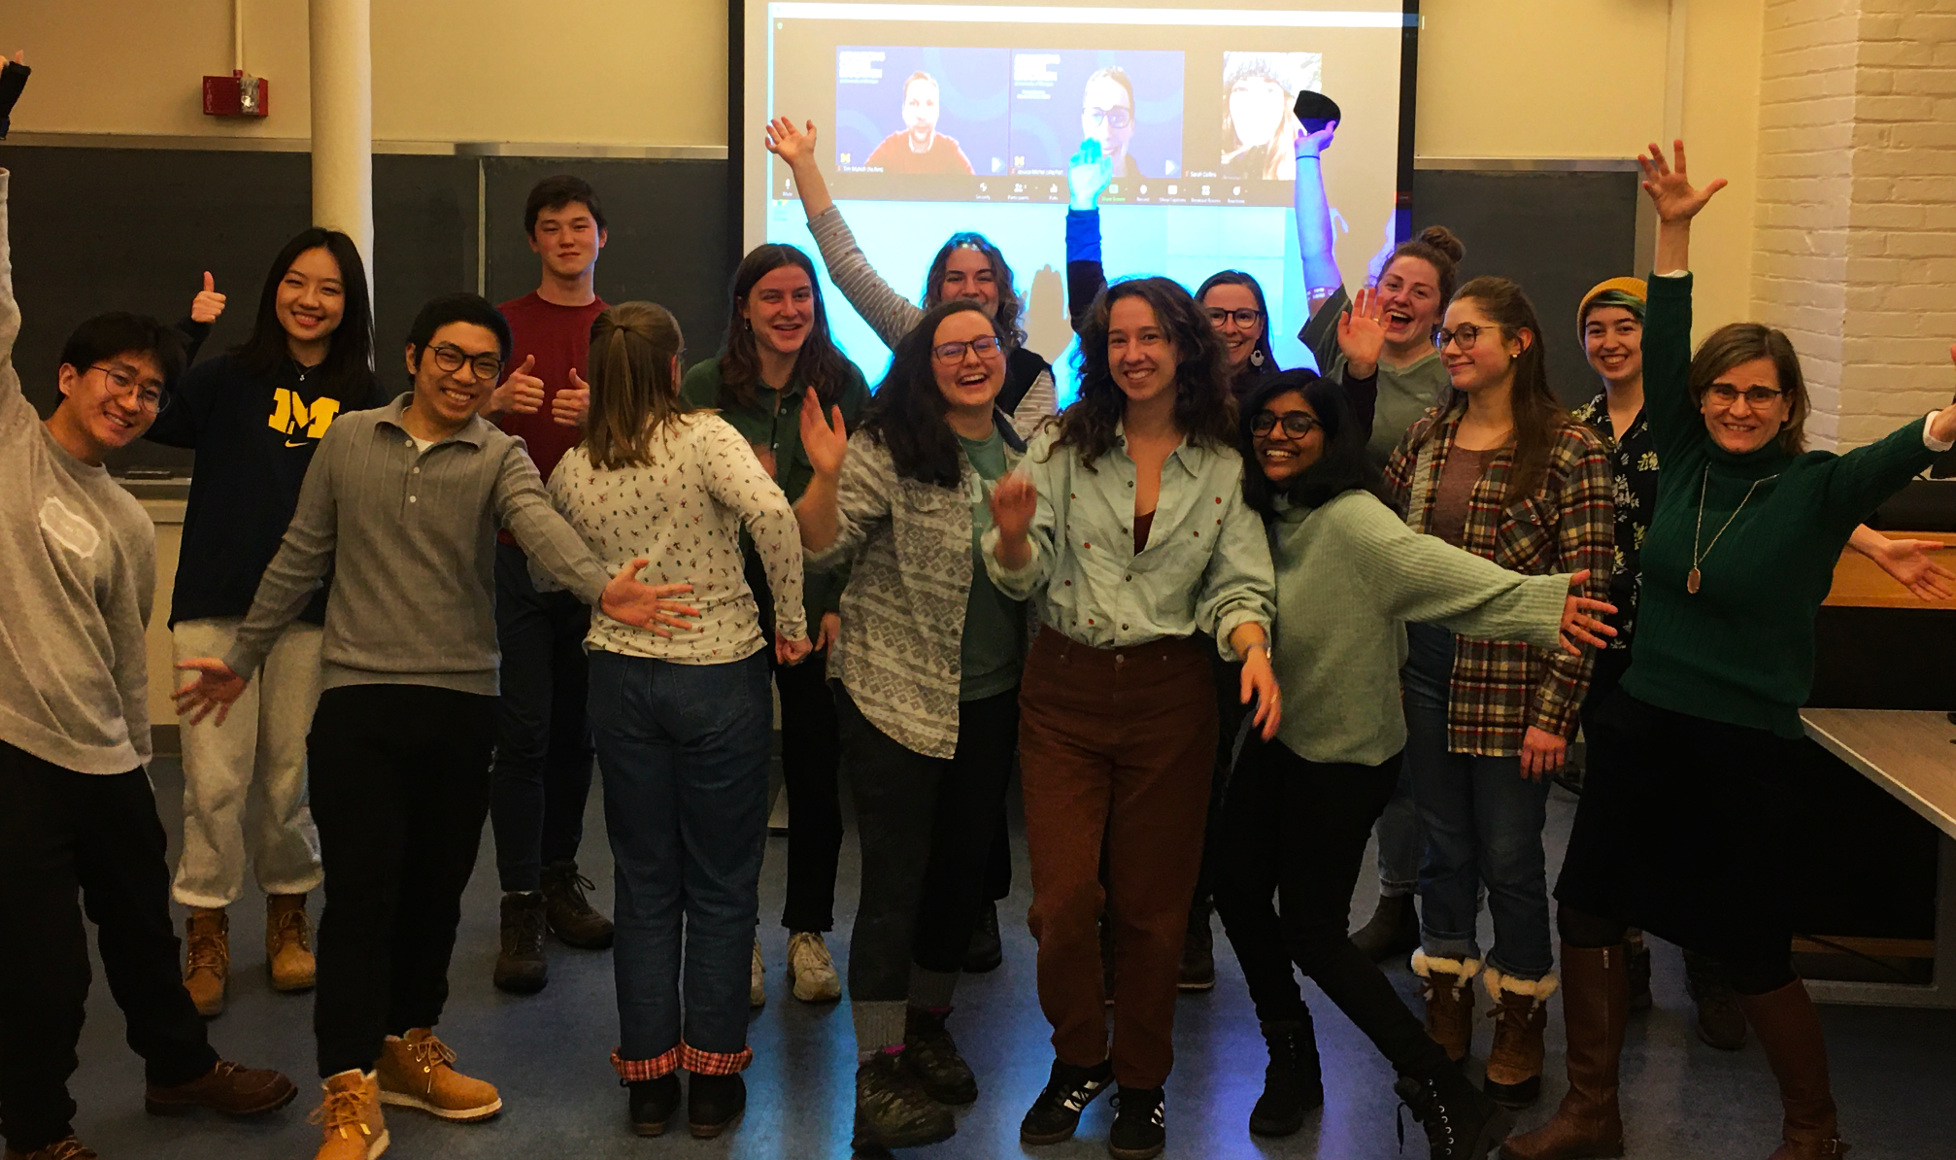
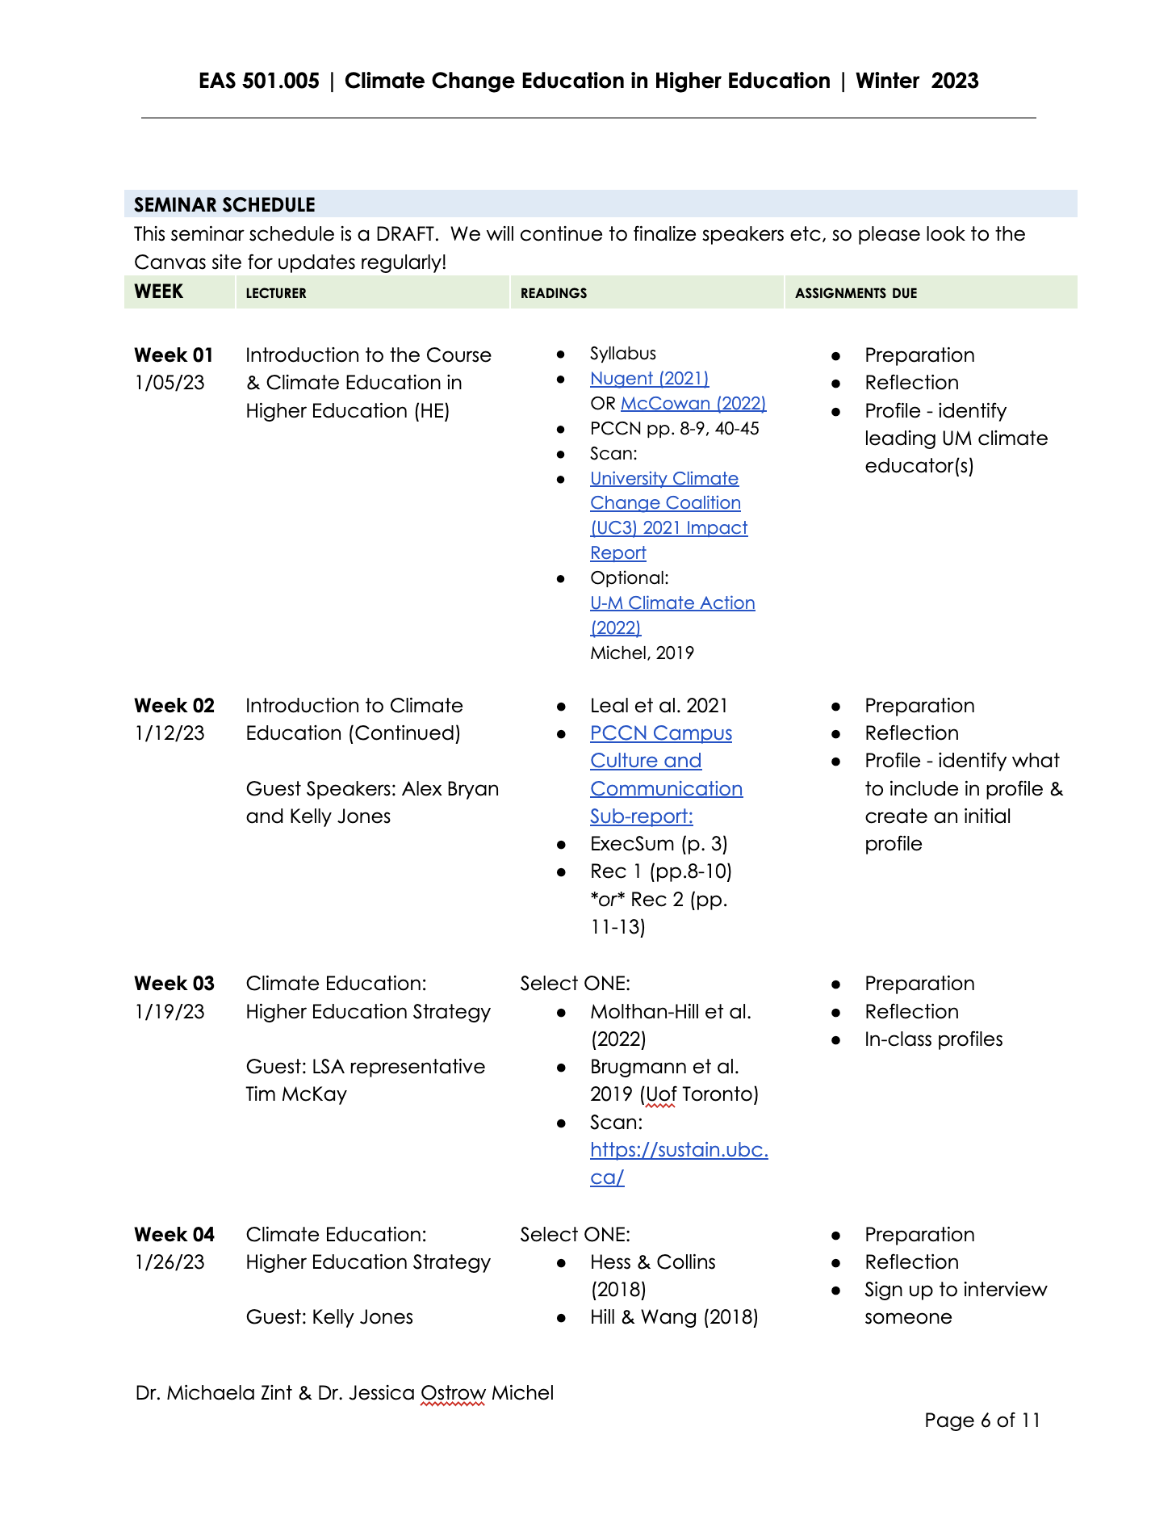
Climate Education Seminar
EAS 501.005
Climate Change Education in Higher Education
Full Semester | 2 credit course
16 students: 4 undergraduate, 11 Masters, 1 Doctoral
From 5 Schools: LSA College of Literature, Science and the Arts, SEAS School for Environment and Sustainability, Public Policy Gerald R. Ford School of Public Policy, Urban Planning Taubman College of Urban Planning, SOE Marshal Family School of Education
✣

Slide 4
Provost Seminar on Teaching & Learning:
Advancing Climate Education at U-M | Agenda
Monday Evening
7:00 Introduction: President Ono (video), AD Zint
7:15 Scavenger Hunt, Visit Tables, Posters and Activity Stations
7:50 Musical Performance by Alexis Lamb
8:00 Student breakout groups
8:50 Ending remarks
9:00 End
Tuesday Morning
8:30 Registration and Breakfast
9:00 Introductory Remarks and Panel Discussion
10:00 Overviews of concurrent sessions
10:10 Break and transition to sessions
10:20 Concurrent Sessions
11:30 Gallery walk of concurrent sessions
12:00 Lunch and Discussion of Next steps
1:00 End
142 from 16 schools registered (62 students, 33 Faculty, 47 staff/admin/other)
69 from 9 schools attended (35 students, 4 Faculty, 29 staff/admin)
116 from 16 schools registered (38 students, 35 Faculty, 43 staff/admin)
60 from 10 schools attended (16 students, 17 Faculty, 27 staff/admin/other)
✣

Slide 5
Event Feedback
SEAS Seminar Students
“The student breakout session I participated in leads me to believe we have been on the right track with our recommendations. We had really strong conversation.”
“The event went amazingly well! Everyone was thoroughly engaged. We did a great job of coming up with activities and conversation starters and they served their purpose. If there were some activities people did not engage with, we shouldn't see that as a shortcoming, because what we really wanted was to stimulate conversations. Activities were there to initiate engagement but it was happening organically without them!”
“I think the flow of the event worked really well, I liked the mix of large group activities, presentations /performances, and small group breakouts. It seemed to keep everyone engaged and the event progressed very smoothly!”
✣

Slide 6
Event Feedback from Attendees
“Such a rare and valuable opportunity for cross-school discussion.”
“I think that events like these with people of power and students conversing in order to come up with ideas are really important because it allows us students to provide our perspectives to genuinely create change.”
“After our discussion, I had 2 feasible ideas to implement in my unit. I am already working on a potential internal grant for that.”
“Not very many faculty were there which is discouraging. The folks in the room are the usuals. Clearly, everyone is doing the best they can. BUT UM desperately needs top leadership to make this a priority. Just as they did with DEI. And it needed to happen 5 years ago! How much longer can these engaged faculty, staff and students hold their breath waiting?? 2030 is around the corner.....”
✣

Slide 7
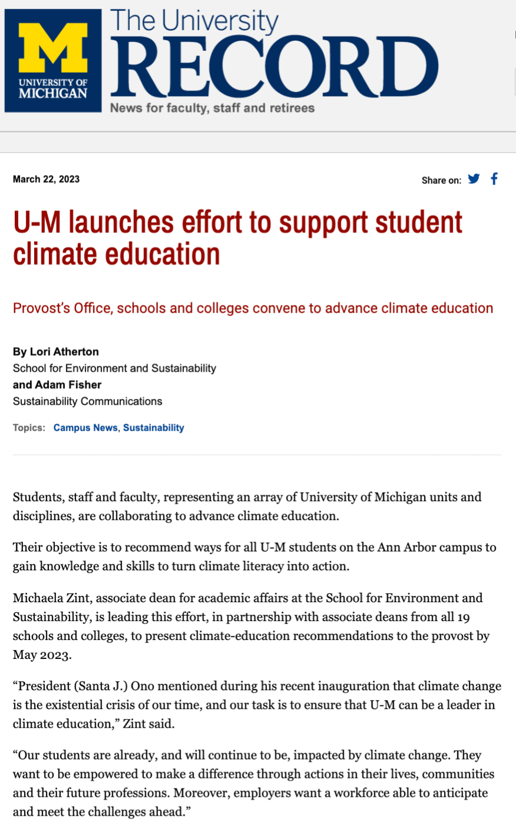
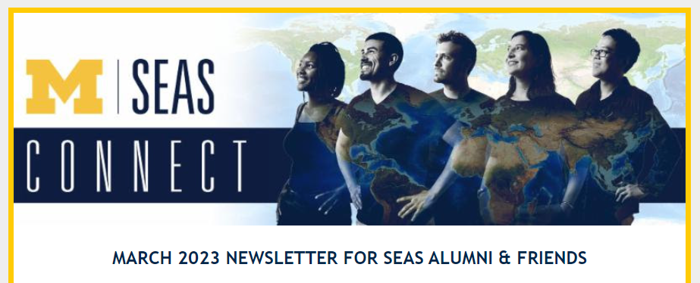
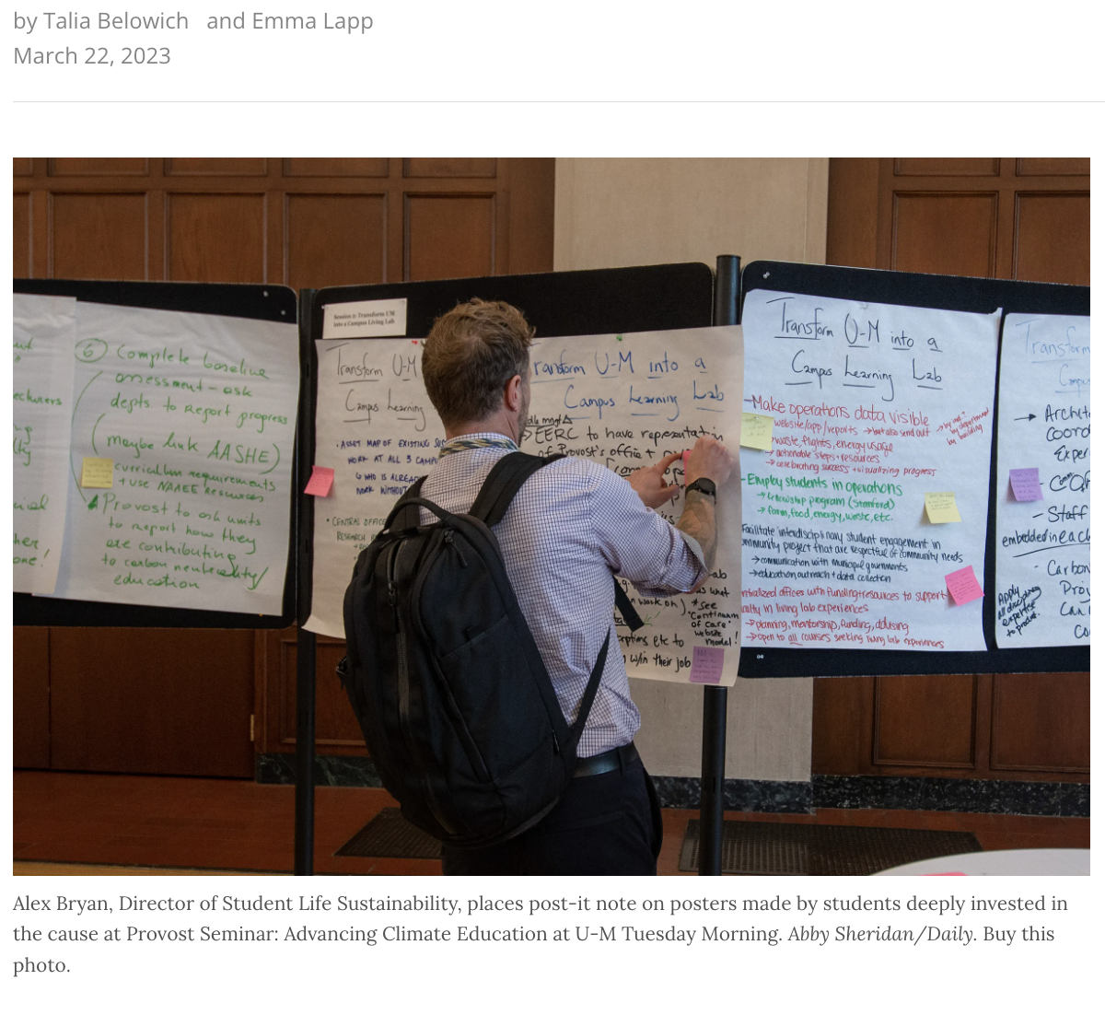
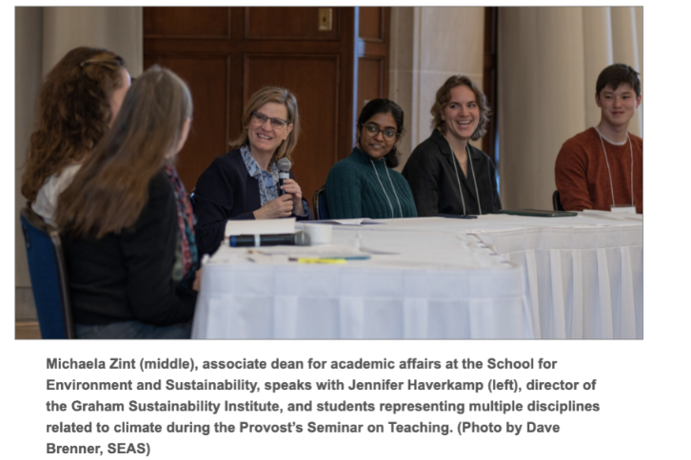
Press Releases
📂
Folder with article links and photos here
✣

Slide 8
Monday’s Student Breakout Sessions:
Why is climate education important to you?
Want to be a “leader and best” change agent about what actually matters
It’s a global, current issue that can’t be ignored, students need to be prepared
There is a need to move from belief/knowledge to action
Increases workforce preparedness
Understand and communicate scientific facts about climate change
Exposure to interdisciplinary, multi-perspective learning
Community building both on campus in our local communities
Increases hope and decreases helplessness in the face of climate change
✣

Slide 9
Monday’s Student Breakout Sessions:
(2) What would you like to see at U-M with regard to climate education?
Program requirement for all students relating to sustainability/climate change education
BUT all programs have to have integrated climate education into curriculum
AND Planet Blue training should be required during orientation
Increased interdisciplinary, hands-on/placed-based learning opportunities including more internships/positions/living labs.
Giving students access to training and resources for sustainable living practices
Funding student leaders and initiatives for sustainability
U-M is a partner with the local community, helping both on and off campus become a living example of climate-mindful lifestyles.
Collaboration across campus in decision-making, curriculum, and goal setting for a cohesive learning and living experience
(J)DEI and climate education need to be interlinked; “Prioritize decolonization and reformative justice”
✣

Slide 10
Tuesday’s faculty, student, staff concurrent sessions on overarching recommendations
Support Faculty Professional Development
Transform U-M into a Campus Living Lab
Integrate Climate Education and Sustainability across the Curriculum
Deploy Climate Education for Student Success
✣

Slide 11
Support Faculty Professional Development (PD)
Adopt/implement Emory University’s Piedmont model (i.e., interdisciplinary PD for infusing climate/sustainability education) to support individual faculty
Create PD (modeled after U-M MORE committee) to support infusion of climate/sustainability education within departments
As part of both of the above, include content on climate justice/anxiety/resilience/linkages to DEI/decolonizing, student success and effective pedagogies
Hold annual climate education event (feature best practices from campus and beyond)
incorporate into above PD
Conduct baseline survey to assess current infusion of climate education in curricula, to identify best practices & measure progress over time
Create incentives/support infusion of climate education into curricula in addition to PD structure for PD (fund students to support infusion, offer unit/university wide awards, recognize effort/progress/innovation not just accomplishment, stipends for faculty, adjust P&T/annual evaluations)
Need to not overwhelm faculty!
✣

Slide 12
Already In Process: CRLT will pilot an Embed Climate
Change in Courses (EC^3) Retreat
When: July 11 & 12, 2023
Where: Adventure Education Center at Radrick
Goal: Provide a community of support to faculty interested in embedding education on climate change into an existing course.
Structure: Loosely modeled after Piedmont Project at Emory. Mix of presentations, discussion, individual planning, & peer feedback. Reunion in AY 2023-2024 to compare notes and share experiences.
Stipend: $500 stipend for 15-20 participants
Application: Distributed in Late April/Early May
✣
Notes:
Matt to add information based on his email to me/Michaela (see below)
Hi Michaela. I wanted to give you a heads-up about an event CRLT is working to organize that is a direct outcome of the Provost’s Seminar you and your students worked so hard on. Please note that this program will not involve work on your part. Deb Meizlish is collaborating with Sara Soderstrom on planning and organization.
Here’s some background: At the Provost’s Seminar lunch on Tuesday, Deb was involved in a conversation with several faculty, including Sara Soderstrom, who expressed interest in piloting a course planning retreat modeled after Emory’s Piedmont Project. The goal would be to provide a community of support to faculty interested in embedding education on climate change into an existing course. Deb approached Malinda and me about the possibility of using CRLT’s faculty learning community funding to support the idea (this is a pool of money CRLT consultants can apply to use for one-time pilots of faculty learning communities that they design and facilitate or co-facilitate). We have approved using this money for a pilot which would provide up to 20 participants with a $500 stipend.
Deb has had preliminary conversations with Sara Soderstrom, and they are hoping to pull together a 2-day retreat for May 17th & 18th. If that proves impossible, they will work towards a retreat in the 2023-2024 academic year.
Deb and Sara would be glad to provide more information as the details (e.g., finding a space) get finalized. In the meantime, if you are available to attend a possible May retreat, we wanted to make sure you could hold the dates for now.
Best,
Matt

Slide 13
Transform U-M into a Campus Living Lab
Create an asset map of living learning lab opportunities across U-M campuses
See the Wellbeing Collective website as a potential template
Centralized office/position for “campus-as-lab” coordination, with funding, resources, and logistical support for faculty to integrate living learning lab experiences into existing courses
Expand funding and support for university-wide communities of practice in climate/sustainability
Coordinate with facilities to employ students in campus operations and/or host interdisciplinary student project teams to push forward carbon neutrality goals
Example: Stanford’s Living Lab Fellowship Program
Leverage existing community engagement structures across campus to use Michigan communities as living labs for sustainability and climate mitigation/adaptation strategies
Ginsburg, SEAS Sustainability Clinic, Public Health Action Support Team, etc.
Develop hands-on learning experiences for regionally specific decarbonization projects
✣

Slide 14
Integrate Climate Education and Sustainability
across the Curriculum
Expand upon sustainability citizen at U-M (Toronto model) to different forms of learning. Examples for the three levels:
Citizen: Planet Blue training for all incoming students (part of orientation)
Scholar: Sustainability Cord program expansion
Leader: Community-based projects
Develop a general degree requirement for climate change and sustainability modeled on the Race and Ethnicity LSA Requirement. Courses/co-curricular opportunities should be categorized or scaled to indicate the expected prerequisite knowledge. There should be ample opportunities for students to engage in climate/sustainability education across course levels.
Create and regularly update an inventory of classes and co-curricular opportunities (coded to the Sustainable Development Goals) for students to choose from. Included classes should be hands-on, experiential, real-world, and collaborative.
Create an accountability system within units to ensure quality designations, to ensure that courses meeting the graduation requirement address needed competencies and follow climate education best practices.
Provide support for faculty infusing climate education including syllabi, sample lesson plans, expert assistance, collectively curated pedagogies for climate education.
This support must ensure that climate education does no harm (raises climate anxiety) but empowers all but especially BIPOC/vulnerable students
✣

Slide 15
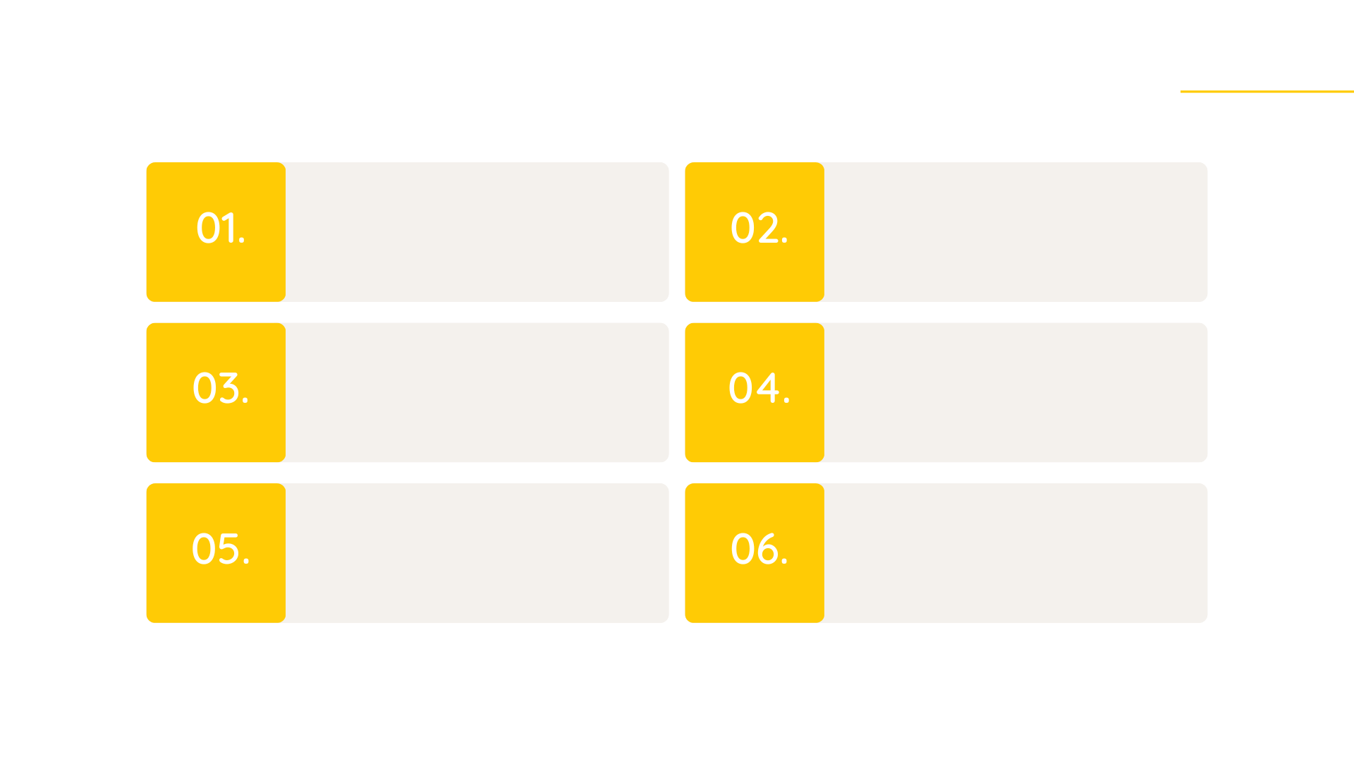
Deploy Climate Education for Student Success
Create short video on what measures drive student success and how climate education can support this U-M goal
Partner with U-M DEI to advance climate education across U-M
Ensure faculty professional development addresses how climate education can improve student success
Identify U-M climate education efforts with the potential to support student success & share outcomes/best practices
Provide funding (through CRLT) for climate education that uses pedagogies that can lead to student success
Encourage Dean Michael Solomon to include climate education within context of “Provost’s Initiative Planning for Student Academic Success” and offer Q&A to both him and Provost McCauley
✣

Slide 16
Deploy Climate Education for Student Success
Traditional Student Success Outcome | Outcome Advanced by Climate Education
Retention, Persistence, & Graduation Rates | Build community and passion around addressing climate change which can lead to sense of belonging
Moral development | Foster empathy for those experiences climate injustice
Cognitive and intellectual development | Enable students think critically about how to solve wicked problems associated with the climate crisis
Career and Economic Impacts of College | Prepare students in all disciplines for climate leadership within their careers
Quality of Life | Cultivate hands-on climate education that results in skills related to: adaptation/resilience, collaboration, community engagement, personal development, etc.
Can be achieved through professional development, integrating climate education across curriculum, & living learning labs
✣

Slide 17
Other Key Recommendation(s)
Central website with information about climate education opportunities across campus
Including role specific information for students, staff, and faculty
Central office/position, reporting to the Provost, with sufficient staff and resources to coordinate efforts at scale
Including funding for their work
Dedicated group (of students, staff, and faculty) on climate education to keep this early momentum going
✣

Slide 18
Support Faculty
Professional Development
Integrate Climate Education and Sustainability across U-M Curriculum
Key Competencies in Sustainability in Higher Education
Values Thinking Competency
Future Thinking Competency
Systems Thinking Competency
Intrapersonal Competency
Strategic Thinking Competency
Implementation Competency
Interpersonal Competency
Transform U-M into a Campus Living Lab
Deploy Climate Education for Student Success
✣

Slide 19
Next Steps:
Submit report (end of May) to share recommendations with U-M leadership based on additional survey feedback from task force/event registrants/participants
Offer EAS 501.005 Climate Education F’23
Questions for your unit:
How can we (ADs), collectively, continue to advance climate education?
What can we (all) do to obtain necessary support from U-M Leadership?
zintmich@umich.edu
✣

Slide 20
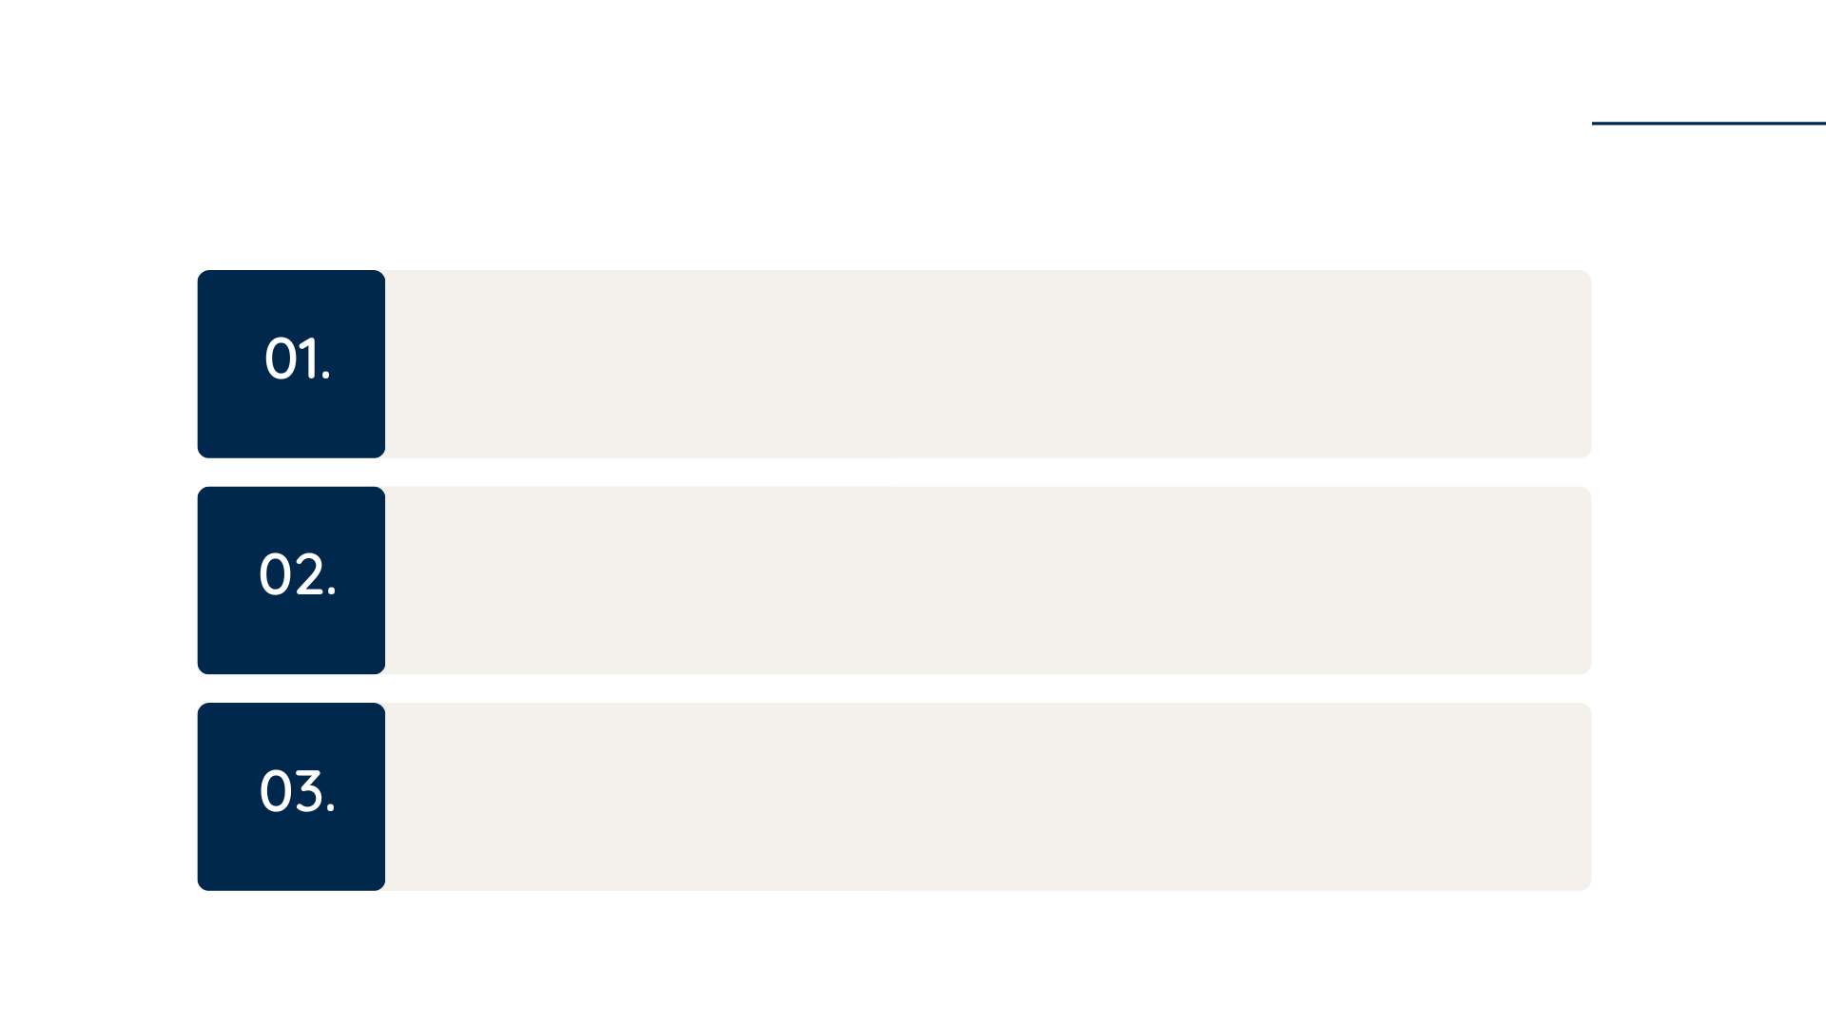
Break Out Groups
For each of the sets of recommendations assigned to your group:
How supportive might your unit be to advance these recommendation? Why/not? How could your unit support these recommendations?
How might these recommendations help your unit move forward with infusing climate education across your curricula?
What questions/concerns do you have about these recommendations?
✣

Slide 21
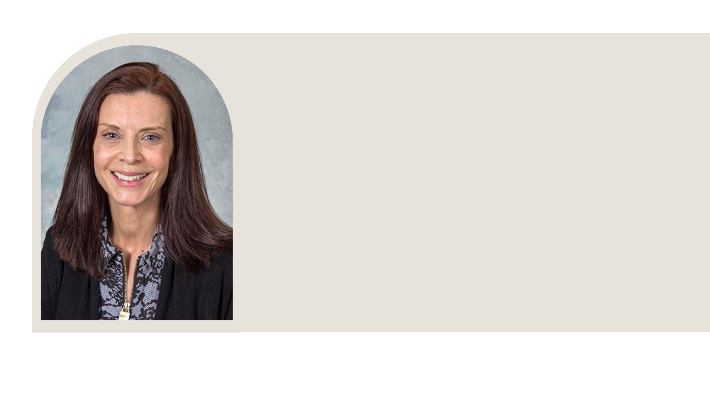
Already In Process
Elisabeta Karl is pursuing educational grant Dentistry with support from Michaela Zint (SEAS)
Goal: Support colleagues by creating a short and interactive set of videos about climate change and sustainability.
✣

Slide 22
Already In Process
Online and blended learning opportunities - SEAS
SEAS Linkedin Learning: Creation of a collection on Green Skills including content from Linkedin and from Gala.
SEAS Mediaspace: online webinar, lectures, etc. edited and gathered into the same Mivideo to facilitate access.
EAS MOOCs: We applied for the creation of 6 MOOCs related to green skills, sustainability, environmental justice and climate change. Plan is to soon offer 1 Mastertrack, and 3 MOOCs series available to anyone.
UMCI: Starting to explore how we can impact Climate Education in Detroit (for graduates and community).
BootCamp: starting to explore the feasibility of offering a bootcamp for Chief Sustainability Officers.
✣

